Slide 1
Library Management System
presented by
1. Balasa Poojitha ( 24KB1A3006 )
2. Bandi Vennela ( 24KB1A3009 )
3. Marella Pavani ( 24KB1A3059 )
4. Vemanaboina Sushmitha ( 24KB1A30C6 )

Slide 2

LIBRARY MANAGEMENT SYSTEM
The Library Management System in c helps manage book records , issues , search , delete and returns.
It uses data structures like Arrays, Binary files for data handling.
This project demonstrates practical applications of DSA in a real - world system.

Slide 3
Key Features of an LMS
Structured Book Records
Core Functionalities
Uses a struct book to store book ID, title , and availability status.
Add Book ,Display books , Issue , Return , Search for a book , Delete book.
Check input validation
User - friendly interface
Checks for duplicate IDs before adding a book and Handles invalid choice.
Displays a clear menu and prompts user input and Wait for enter key to continue between operations.

Slide 4

Data Structures Used
Arrays
Store book and member ID lists
File handling
binary file : library.dat , modes used.
Source Code :
https://onlinegdb.com/1mysXh5g8

Slide 5








Advantages of Using LMS
Increased Efficiency
Improved Accuracy
Better Resource Management
Enhanced User Experience

Slide 6
Limitations and Challenges
1
No Authentication(anyone can operate)
2
No Database integration(limited scalability)
3
Technical Expertise
Needs maintenance and troubleshooting skills
4
Security Concerns
Safeguarding sensitive member data
5
Example
Smaller libraries may struggle with initial costs

Slide 7
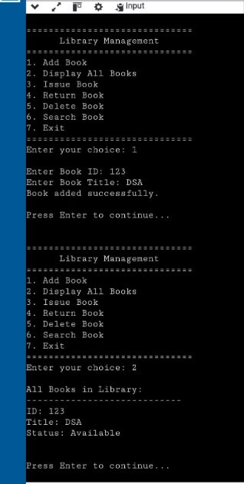
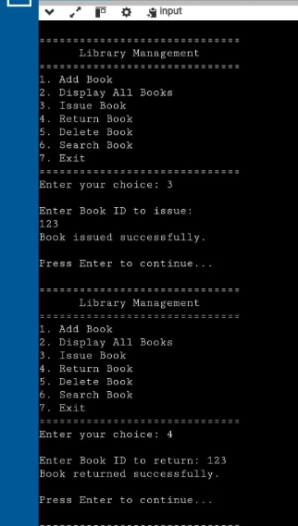
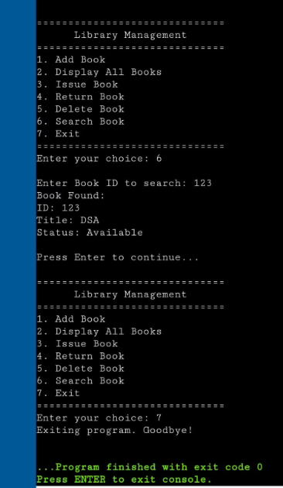
OUTPUT :

Slide 8
THANK YOU

